Slide 1

Final Presentation: Data Mining Applications
By:
Viraj Mehta
Vasu Ambasana
Karan Daiya
Hongyang Jiang

Slide 2
FIFA 19 Player Dataset
The dataset includes latest edition FIFA 2019 player attributes such as Age, Nationality, Overall, Potential, Club, Value, International reputation, position and many more.
It has total 89 columns.
Context: Football Analytics

Slide 3
This plot represents the Top 10 Highest Valued Players of FIFA 2019. Colors are assigned as the nationality of player and we have used cowplot along with ggplot to create this visual.

Slide 4
This world map denotes the average potential of Soccer players around the globe.

Slide 5
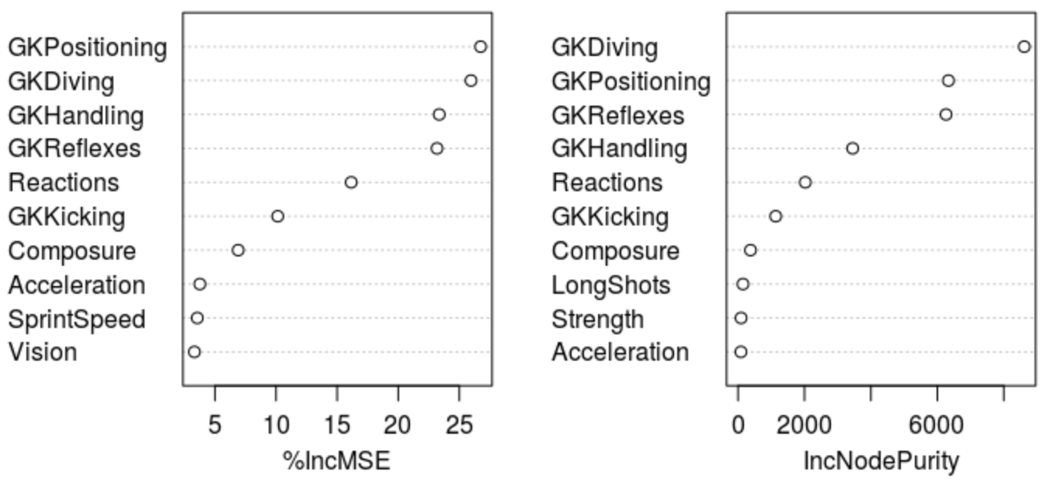
Goal Keepers
The mean squared error is 0.9403433.

Slide 6
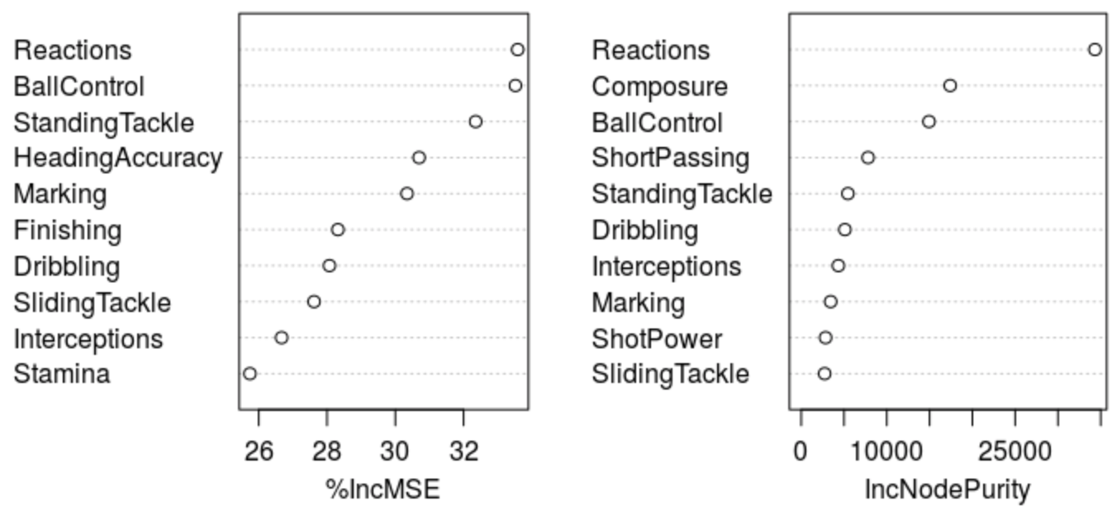
Outfielders
The mean squared error is 2.021907.

Slide 7
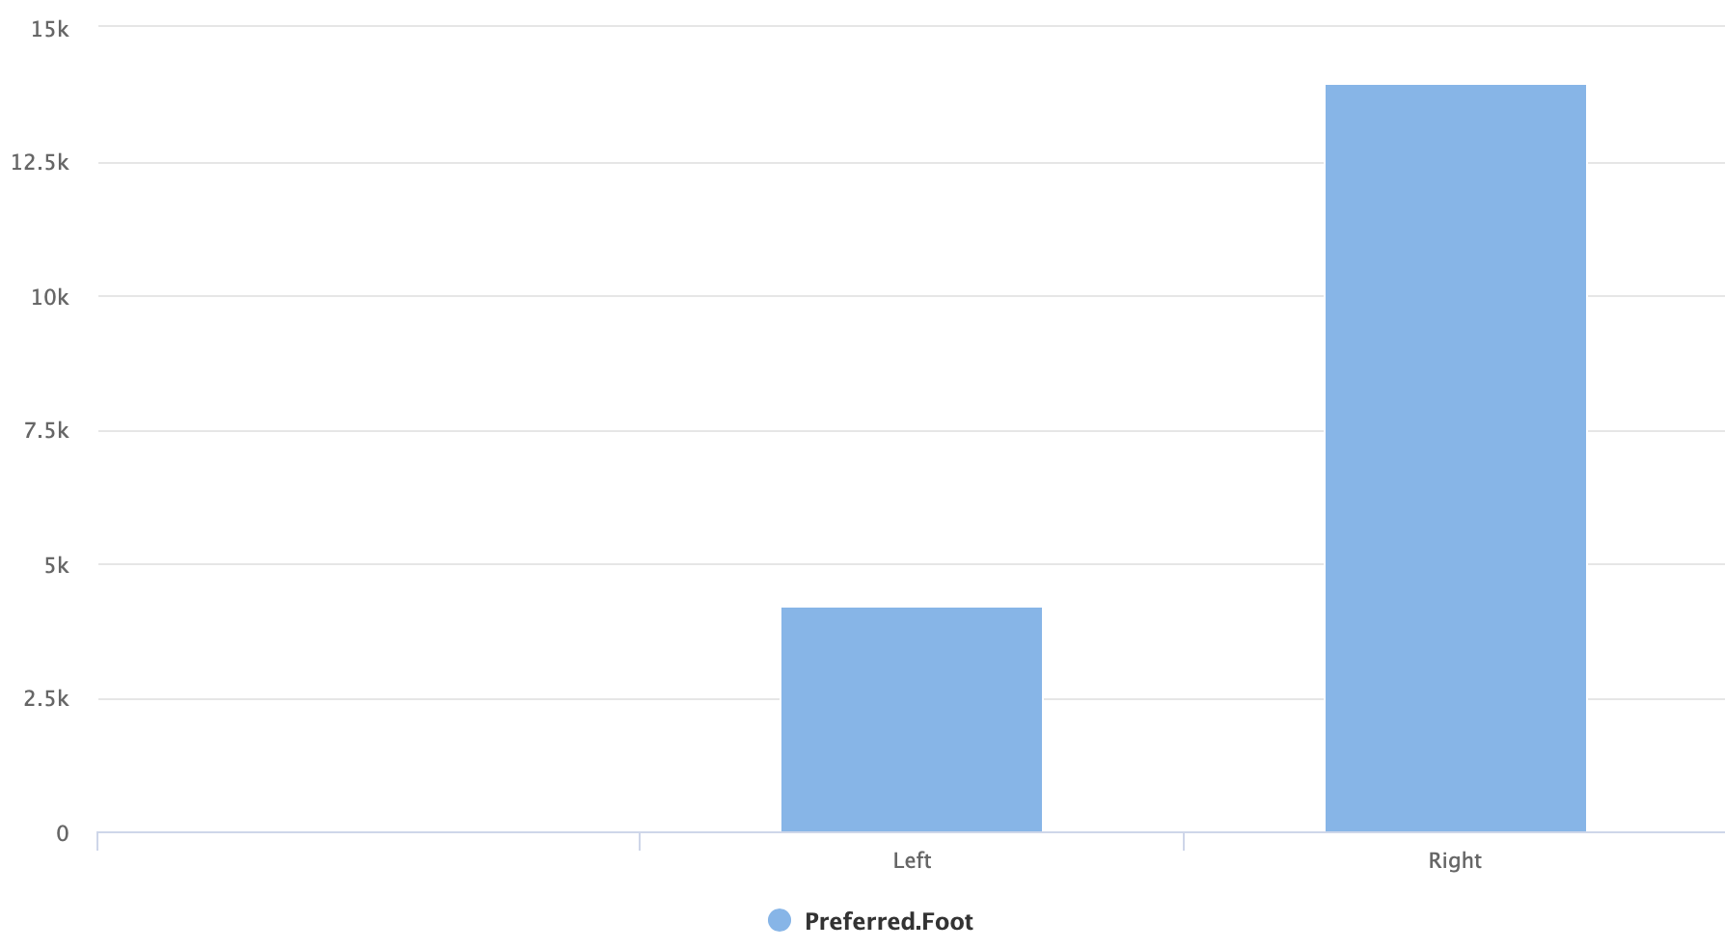
Preferred Foot
In FIFA 2019, out of total 18,159 players, 13,948 prefers right foot and 4,211 prefers left foot while playing.

Slide 8
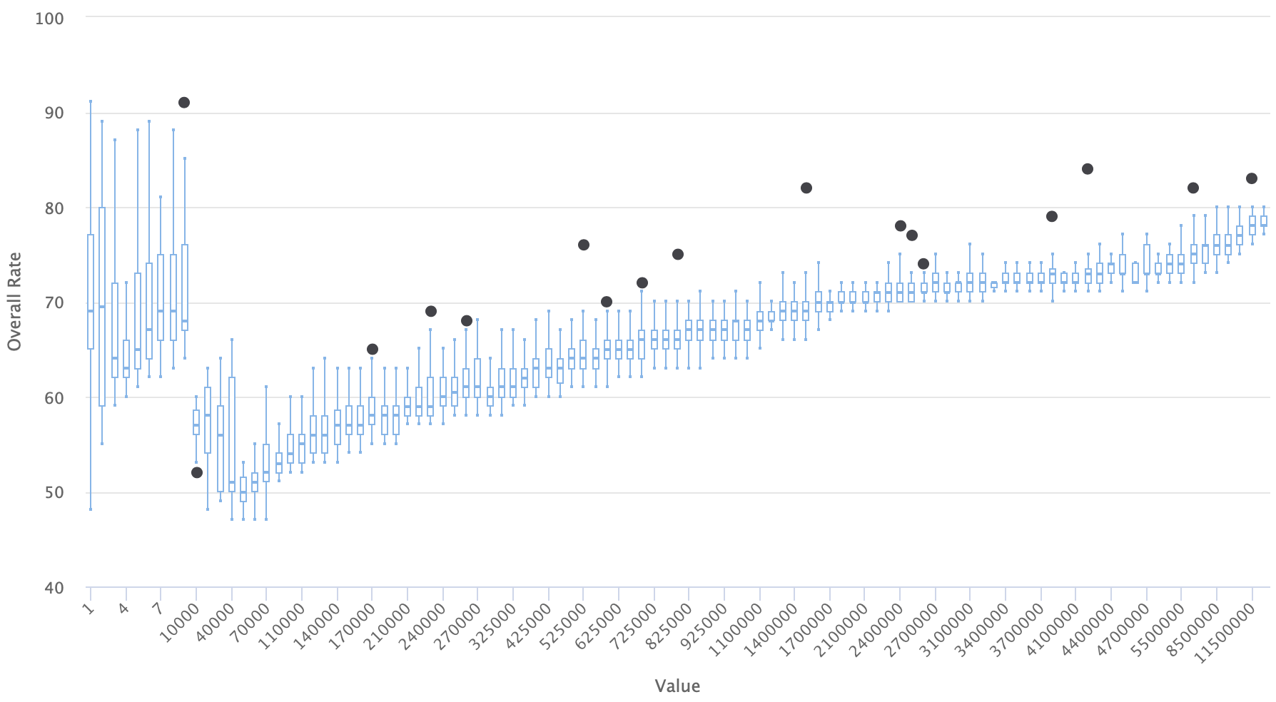
Overall Rating VS Player’s Value
This boxplot represents the comparison between player’s overall ratings and their values. We can observe the correlation that as soon as overall rating increases, value of that player also increases gradually.

Slide 9
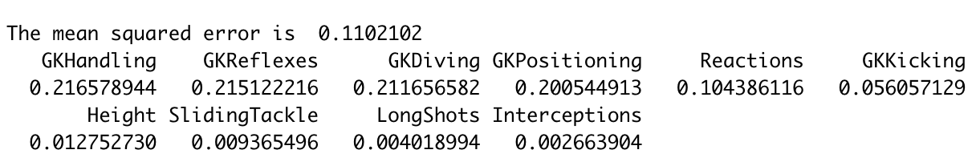
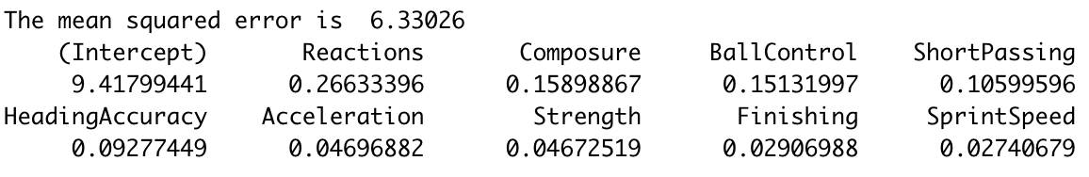
Linear Model of Goal Keepers:
Linear Model:
Linear Model of Outfielders:

Slide 10

Now let’s go to the RShiny Application Dashboard…
Click Here…

Slide 11

Thank You

